Slide 1
Deriving tables from models
COMP3421
Database Systems

Slide 2
Overview
Introduction
Entities and their attributes
Relationships
1:M
M:M
1:1
Unary and Ternary
Generalization and Specialization

Slide 3
Deriving Tables from Models
When a logical model for a relational database is being designed from a conceptual model, the conceptual model needs to be interpreted for the system
This requires translating entities, attributes, and relationships to database objects and constraints
Concerns that are specific to relational databases must now be applied

Slide 4
Deriving Tables from Models
Logical modeling concerns for relational databases
Entity integrity
Every record must have a unique primary key
The primary key cannot be NULL
Composite keys cannot have any NULL components
Referential integrity
Every non-NULL foreign key value must exist in its parent table and be its primary key

Slide 5
Overview
Introduction
Entities and their attributes
Relationships
1:M
M:M
1:1
Unary and Ternary
Generalization and Specialization

Slide 6
Entities and their Attributes
Each entity should be implemented as a database table
Each entity instance will then correspond to a record in that table
Each entity attribute should be implemented as a field in its corresponding database table
If an attribute is a key, then it should be a primary key of its corresponding database table

Slide 7
Entities and their Attributes
Composite attributes
If an attribute is composite in the data model, and it makes sense to search, sort, or format according to its components, then it should be broken up into multiple atomic attributes
Otherwise, it’s okay for the attribute to remain composite
For example, an “address” attribute that is intended to include the entire mailing address could be split into “street”, “city”, “state”, and “zip” if searching or sorting may occur according to those components

Slide 8
Entities and their Attributes
Multivalued attributes
If there is no upper limit on the number of values
The attribute should instead be a weak entity
For example, a “phone numbers” attribute could instead be a weak entity, allowing for a variable number of numbers per entity instance
If there is an upper limit on the number of values, and that upper limit will always be reached
The attribute should be split up into multiple fields in its corresponding database table
For example, a “phone numbers” attribute could instead be “home phone” and “work phone” attributes in their corresponding database table

Slide 9
Entities and their Attributes
Derived attributes
If the underlying attribute value might change, then represent the derived attribute as a field in the corresponding database table
Otherwise, represent the underlying attribute(s) (the one(s) that can be used to produce the derived attribute) as a field(s) in the corresponding database table
For example, an “order total” derived attribute would be preferable in situations where its derived attributes “num products” and “product price” might change
What happens in our candy database if a product price changes and we need to calculate a prior purchase cost?

Slide 10
Sample Database (CANDY)
CANDY_CUSTOMER
CANDY_PURCHASE
CANDY_CUST_TYPE
CANDY_PRODUCT

Slide 11
Overview
Introduction
Entities and their attributes
Relationships
1:M
M:M
1:1
Unary and Ternary
Generalization and Specialization

Slide 12
Relationships
Relationships should be implemented using foreign keys
Exactly how depends on the relationship cardinality and optionality
1:M
M:M
1:1

Slide 13
1:M Relationships
Reference the primary key of the entity on the “1” side of the relationship as a foreign key in the entity on the “M” side of the relationship
Department
DID
DName
DOffice
Employee
EID
EName
Eoffice
Works In
DEPARTMENT(DID, DName, DOffice)
EMPLOYEE(EID, EName, EOffice, DID)
DID | DName | DOffice
1 | Accounting | SSS415
2 | MIS | SSS406
3 | Production | SSS312
EID | EName | EOffice | DID (FK)
100 | Smith | SSS112 | 1
200 | Jones | SSS116 | 1
300 | Brown | SSS107 | 2

Slide 14
1:M Relationships
Why can’t you reference the primary key of the entity on the “M” side of the relationship as a foreign key in the entity on the “1” side of the relationship?
We would need to either:
Treat the foreign key like a multivalued attribute, or
Use multiple records to represent a single entity
(Neither situation is appropriate)

Slide 15
1:M Relationships
Incorrectly representing 1:M relationships by treating the foreign key as a multivalued attribute
DID | DName | DOffice | EID
1 | Accounting | SSS415 | 100, 200
2 | MIS | SSS406 | 300
3 | Production | SSS312
Now we have a multivalued attribute represented as a single field in our table, which cannot serve as foreign key

Slide 16
1:M Relationships
Incorrectly representing 1:M relationships by using multiple records to represent a single entity
DID | DName | DOffice | EID
1 | Accounting | SSS415 | 100
1 | Accounting | SSS415 | 200
2 | MIS | SSS406 | 300
Now we have non-unique primary key values

Slide 17
1:M Relationships
Our candy database has the following 1:M relationships
CANDY_CUST_TYPE to CANDY_CUSTOMER
CANDY_CUSTOMER to CANDY_PURCHASE
Notice how the primary keys for CANDY_CUST_TYPE and CANDY_CUSTOMER are referenced by foreign keys in the CANDY_CUSTOMER and CANDY_PURCHASE tables (respectively)

Slide 18
Sample Database (CANDY)
CANDY_CUSTOMER
CANDY_PURCHASE
CANDY_CUST_TYPE
CANDY_PRODUCT

Slide 19
1:M Relationships
If the entity on the “1” side of a 1:M relationship is mandatory, then the foreign key must be declared NOT NULL
Otherwise, the foreign key can allow NULL values
EID | EName | EOffice | DID (fk, nn)
100 | Smith | SSS112 | 1
200 | Jones | SSS116 | 1
300 | Brown | SSS107 | 2
Department
DID
DName
DOffice
Employee
EID
EName
Eoffice
Works In

Slide 20
Overview
Introduction
Entities and their attributes
Relationships
1:M
M:M
1:1
Unary and Ternary
Generalization and Specialization

Slide 21
M:M Relationships
Reference the primary keys of both entities using foreign keys in a new “linking” or “bridge” table
These foreign keys in the linking table would combine to form a composite primary key in the linking table
Project
PID
PName
PStart
Employee
EID
EName
Eoffice
Works On
PID | PName | PStart
1 | Help Desk Intranet | 01/05/15
2 | Cold Fusion Study | 01/15/15
3 | Oracle Conversion | 11/15/14
PID (fk) | EID (fk)
1 | 100
2 | 100
2 | 200
EID | EName | EOffice
100 | Smith | SSS112
200 | Jones | SSS116
300 | Brown | SSS107

Slide 22
M:M Relationships
If the M:M relationship has attributes, place them in the linking table
A linking table may be necessary for other relationships with attributes as well
Project
PID
PName
PStart
Employee
EID
EName
Eoffice
Works On
EmpProjHours
PID (fk) | EID (fk) | EmpProjHours
1 | 100 | 30
2 | 100 | 15
2 | 200 | 25

Slide 23
M:M Relationships
How many tables are needed to translate the following conceptual model into a logical model for a relational database?
Car
CarVIN
CarMake
CarModel
CarYear
Customer
CustomerID
CustomerName
owns
3
4
5
None of the above
has
WorkOrder
WorkorderID
WorkorderDate
Service
ServiceID
ServiceDesc
ServiceCharge
has
ServiceHours

Slide 24
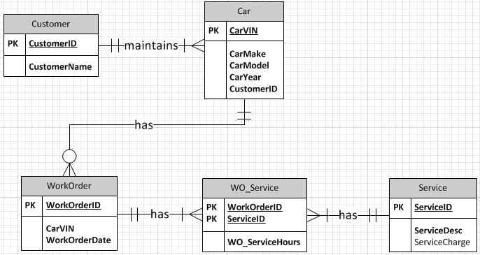

M:M Relationships

Slide 25
Overview
Introduction
Entities and their attributes
Relationships
1:M
M:M
1:1
Unary and Ternary
Generalization and Specialization

Slide 26
1:1 Relationships
Reference the primary key of one entity in the relationship as a foreign key in the other entity in the relationship
Exactly how to do this depends on the optionality of the entities that participate in the 1:1 relationship

Slide 27
1:1 Relationships
If both entities are mandatory
Add the foreign key to the entity that is more likely to need to reference the other entity
Don’t add foreign keys to both entities
This causes a “circular dependency”, which will make it difficult to insert data
Univ_Department
Dept_ID
Dept_Name
Dept_Office
Univ_Associate
Associate_ID
Associate_Name

Slide 28
1:1 Relationships
Example: Both entities are mandatory and the more common question is “Who is a department’s associate?”
Univ_Department
Dept_ID
Dept_Name
Dept_Office
Univ_Associate
Associate_ID
Associate_Name
UNIV_DEPARTMENT
Dept_ID
Dept_Name
Dept_Office
Associate_ID (FK, NN)
Univ_Associate
Associate_ID
Associate_Name

Slide 29
1:1 Relationships
Example: Both entities are mandatory and the more common question is “What department does an associate work for?”
Univ_Department
Dept_ID
Dept_Name
Dept_Office
Univ_Associate
Associate_ID
Associate_Name
UNIV_DEPARTMENT
Dept_ID
Dept_Name
Dept_Office
Univ_Associate
Associate_ID
Associate_Name
Dept_ID (FK, NN)

Slide 30
1:1 Relationships
If only one side is mandatory
Add the foreign key to the entity with optional participation
Faculty
Faculty_ID
Faculty_Name
Faculty_Rank
Office
Office_ID
Office_Bldg
Office_Room
FACULTY
Faculty_ID
Faculty_NAME
Faculty_Rank
Office_ID (FK, NN)
OFFICE
Office_ID
Office_Bldg
Office_Room

Slide 31
1:1 Relationships
If both entities are optional
If a relationship is likely to exist for most entity instances, add the foreign key to the entity that is more likely to have fewer instances
This saves storage space due to less null values
UnivStudent
Student_ID
Student_Name
Is issued
LaptopComputer
Laptop_ID
Laptop_Brand
Laptop_Processor
Univ_Student
Student_ID
Student_Name
LaptopComputer
Laptop_ID
Laptop_Brand
Laptop_Processor
Student_ID (FK)

Slide 32
1:1 Relationships
If both entities are optional
If a relationship is unlikely to exist for most entity instances, create a linking table
This avoids null values in cases where the relationship does not exist and also allows for relationship attributes
UnivStudent
Student_ID
Student_Name
Is issued
LaptopComputer
Laptop_ID
Laptop_Brand
Laptop_Processor
UnivStudent
Student_ID
Student_Name
StudentLaptop
Laptop_ID (FK, NN)
Student_ID (FK, NN)
Checked_Out
Checked_In
LaptopComputer
Laptop_ID
Laptop_Brand
Laptop_Processor

Slide 33
Overview
Introduction
Entities and their attributes
Relationships
1:M
M:M
1:1
Unary and Ternary
Generalization and Specialization

Slide 34
Unary Relationships
The same cardinality considerations for binary relationships can be applied to unary relationships
StudentRoommate
Student1ID (FK)
Student2ID (FK)
Company_Employee
EmployeeID
EmployeeFirstName
EmployeeMI
EmployeeLastName
EmployeeDOB
SupervisorID (FK)

Slide 35
Ternary Relationships
Ternary relationships require a 3-way linking table
More generally, n-ary relationships require an N-way linking table
StudentTutorSession
StudentID (FK)
TutorID (FK)
CourseID (FK)
SessionDate
SessionTime
SessionOutcome

Slide 36
Overview
Introduction
Entities and their attributes
Relationships
1:M
M:M
1:1
Unary and Ternary
Generalization and Specialization

Slide 37
Generalization and Specialization
Create tables for both the more general and the more specific entities
More specific entity is a weak entity
Add a foreign key that references the most general entity to the more specific entities, and make it the primary key of the more specific entities as well

Slide 38
Generalization and Specialization
How should the corresponding logical model be different than this conceptual model?
UniversityPerson
PersonID
PersonFirstName
PersonLastName
StudentPerson
StudentID
StudentMajor
StudentCreditHours
FacultyPerson
FacultyID
FacDepartment
FacRank
FacSalary
StaffPerson
StaffID
StaffTitle
StaffLevel
StaffHourlyRate

Slide 39
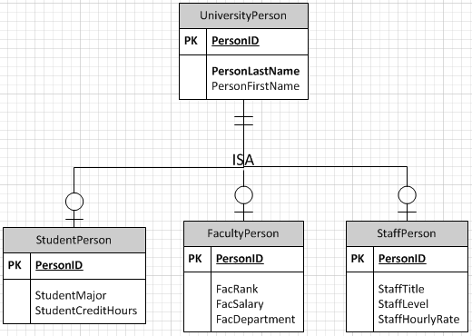
Generalization and Specialization
PersonID is a primary key in all tables and also a foreign key in more specific tables
Would have been okay to keep prior names
A record in a more specific table can only exist when a corresponding record is present in the more general table

Slide 40
Exercise
Derive the relational database tables for this conceptual model of a youth soccer league on the next slide
Create the relational database logical model using Crow’s foot notation
Label PK’s and FK’s and specify whether FK’s can be null
A possible solution is presented after the conceptual model

Slide 41
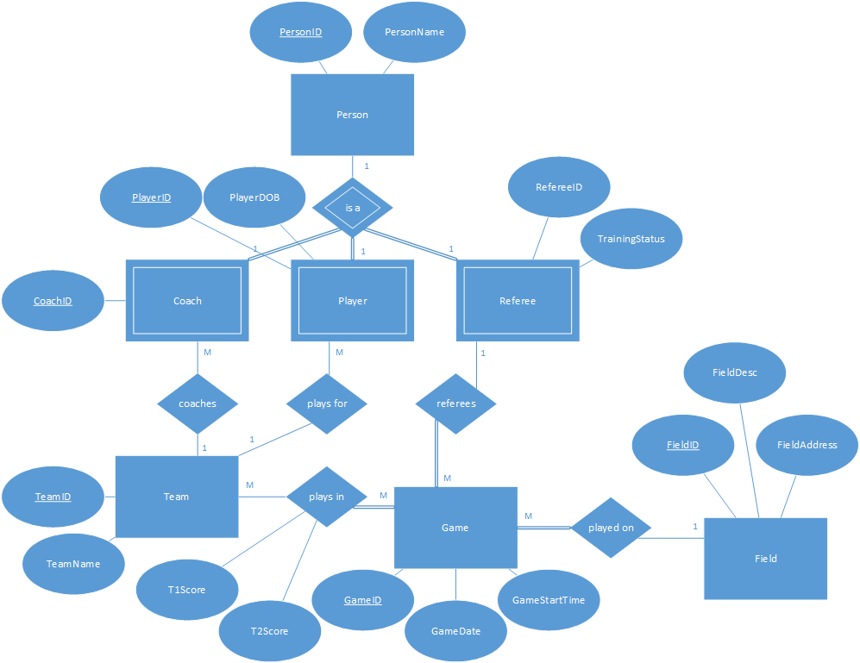
Notes:
~ when considering mandatory participation, ask, “if an instance of that entity exists, does it have to participate in this relationship?”
~ if so, it is mandatory
~ a person can exist without a corresponding coach, player, or referee, but a coach, player, or referee cannot exist without a person
~ a team can exist without a coach and a coach can exist without a team
~ a team can exist without a player and a player can exist without a team
~ a team can exist without playing in games, but a game cannot exist without teams
~ a referee can exist without a game, but a game cannot exist without a referee
~ a field can exist without a game, but a game cannot exist without a field

Slide 42
